Slide 1
Extended ER features
T. JOSHVA DEVADAS
PROFESSOR
SJT ANNEX 103F

Slide 2
EER is a high-level data model that incorporates the extensions to the original ER model.
It is a diagrammatic technique for displaying the following concepts
Sub Class and Super Class
Specialization and Generalization
Union or Category
Aggregation
These concepts are used when the comes in EER schema and the resulting schema diagrams called as EER Diagrams.

Slide 3
A. Sub Class and Super Class
Sub class and Super class relationship leads the concept of Inheritance. The relationship between sub class and super class is denoted with symbol a hollow arrow-head pointing from the specialized entity to the other entity
Super Class : Super class is an entity type that has a relationship with one or more subtypes.
An entity cannot exist in database merely by being member of any super class. For example: Shape super class is having sub groups as Square, Circle, Triangle.
Sub Class : Sub class is a group of entities with unique attributes.
Sub class inherit properties and attributes from its super class. For example: Square, Circle, Triangle are the sub class of Shape super class.

Slide 4
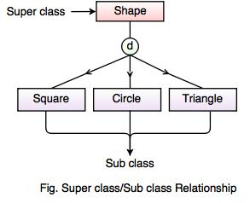

Slide 5
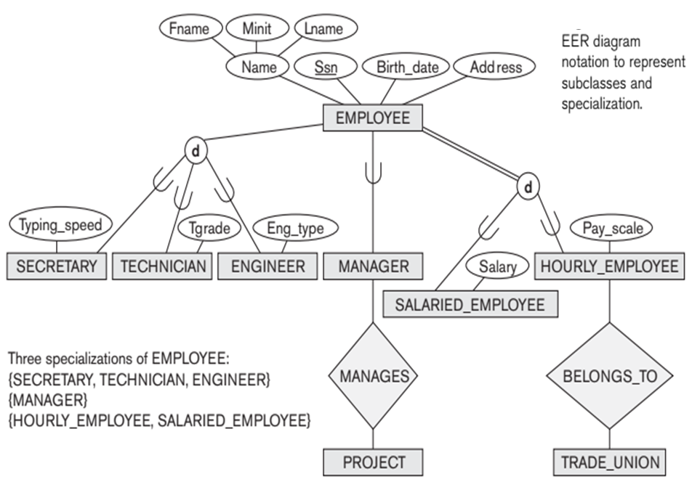

Slide 6
Constraints and its Types
There are three constraints that may apply to a specialization/generalization:
Disjoint Constraints and
Completeness Constraints.
Membership Constraints

Slide 7
Disjointness Constraints on Specialization and Generalization
There are two type of constraints in specializations.
Disjointness specifies that the subclasses of the specialization must be disjoint. The notation of disjoint constraint is
There are four further possible constraints on specialization
Disjoint total
Disjoint partial
Overlapping total
Overlapping partial
Completeness
Decide whether a supertype instance must also be a member of at least one subtype.
D

Slide 8
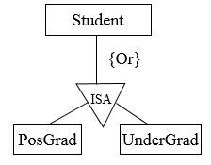
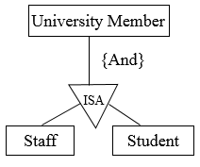
Disjoint Constraint
Disjoint (d)
The subclasses must have disjoint sets of entities
Overlap (o)
The subclasses may have overlapping sets of entities

Slide 9
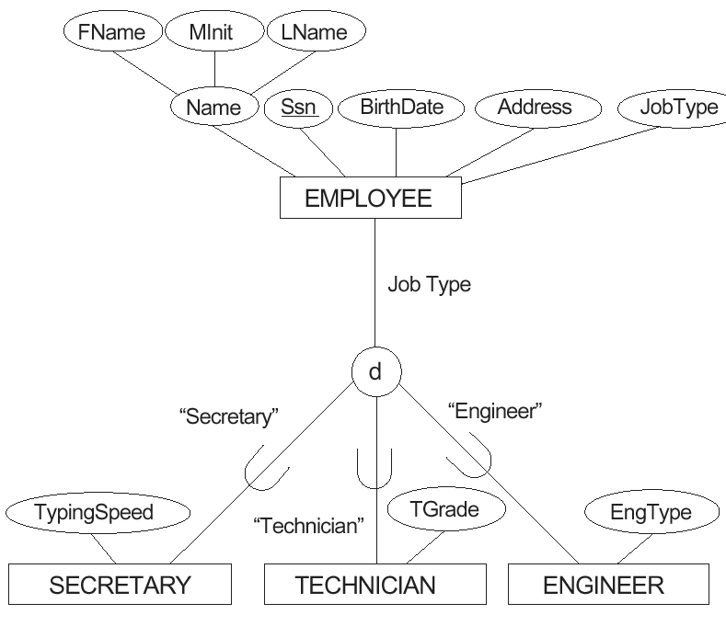
An attribute-defined specialization on the JobType attribute of EMPLOYEE.

Slide 10
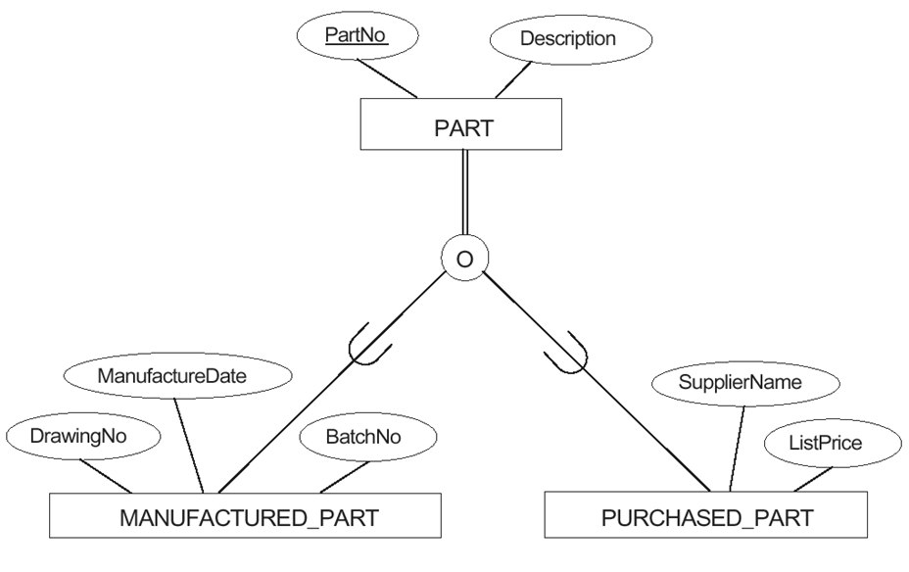
Notation for specialization with overlapping (nondisjoint) subclasses.

Slide 11
Completeness Constraints
Partial
An entity may not belong to any of the subclasses (single-line)
Total
Every entity in the superclass must be a member of some subclass (double-edge)

Slide 12
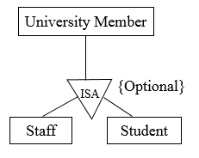
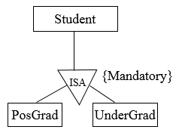
Total Partial
(Specialization) (Generalization)

Slide 13
Membership Constraints
Predicate defined subclasses
The subclass is defined through a predicate on the attributes of the superclass
Attribute defined subclasses
The subclasses in the specialization are all defined by the same attribute of the superclass
User defined subclasses
Membership in the subclasses is determined at the insertion operation level

Slide 14
Specialization
An entity set may include subgroupings of entities that are distinct in some way from other entities in the set.
Specialization is the process of defining a set of subclasses of an entity type. This entity type is called the superclass of the specialization.
It is a top down approach, in which one higher entity can be broken down into two lower level entity.
It maximizes the difference between the members of an entity by identifying the unique characteristic or attributes of each member.
.

Slide 15
In terms of an E-R diagram, specialization is depicted by a hollow arrow-head pointing from the specialized entity to the other entity
The specialization of person allows us to distinguish among person entities according to whether they correspond to employees or students:
In general, a person could be an employee, a student, both, or neither.
We refer to this relationship as the ISA relationship, which stands for “is a” and represents, for example, that an instructor “is a” employee.

Slide 16
An entities B is said to be a subclass of another entity A. If and only if it shares an “is-a” relationship with A.
Example: Car “is-a” vehicle.
Manager “is-a” Employee.
An entity of class B is said to be a specialization of entities of class A.
Conversely, entities of class A are generalization of the class B entities.

Slide 17
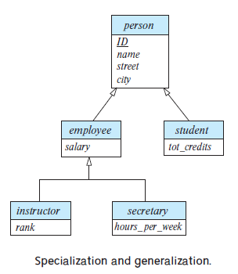
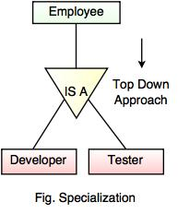

Slide 18
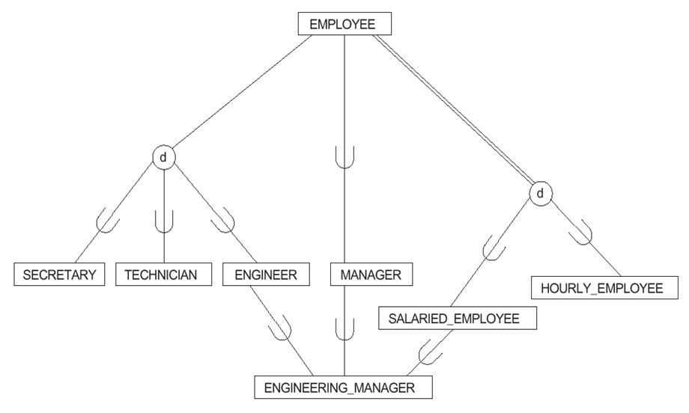
A specialization lattice with the shared subclass ENGINEERING_MANAGER
( with Multiple Inheritance )

Slide 19
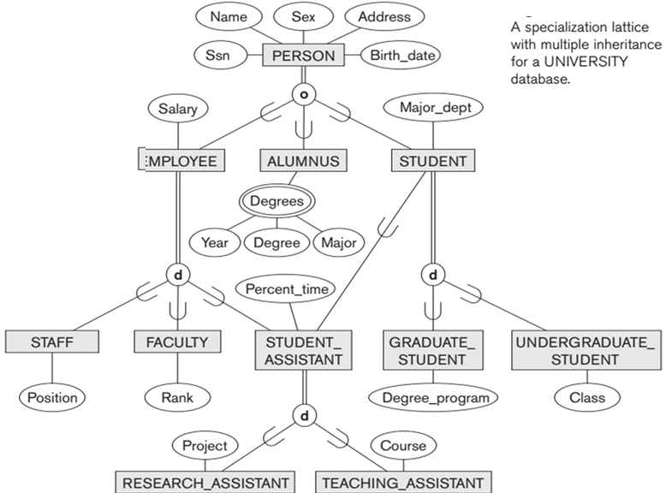
A specialization lattice (with multiple inheritance) for a UNIVERSITY database

Slide 20
Generalization
Multiple entity sets are synthesized into a higher-level entity set, based on common features (bottom-up).
Generalization is the process of generalizing the entities which contain the properties of all the generalized entities.
It is a bottom approach, in which two lower level entities combine to form a higher level entity.
Generalization is the reverse process of Specialization.
It defines a general entity type from a set of specialized entity type.
It minimizes the difference between the entities by identifying the common features. For example:

Slide 21
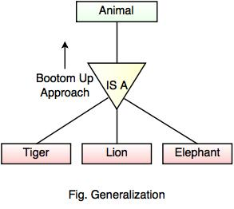
In the example, Tiger, Lion, Elephant can all be generalized as Animals.

Slide 22
Category or Union
Category represents a single super class or sub class relationship with more than one super class.
It can be a total or partial participation. For example Car booking, Car owner can be a person, a bank (holds a possession on a Car) or a company.
Category (sub class) → Owner is a subset of the union of the three super classes → Company, Bank, and Person. A Category member must exist in at least one of its super classes.

Slide 23
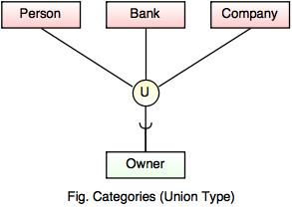

Slide 24
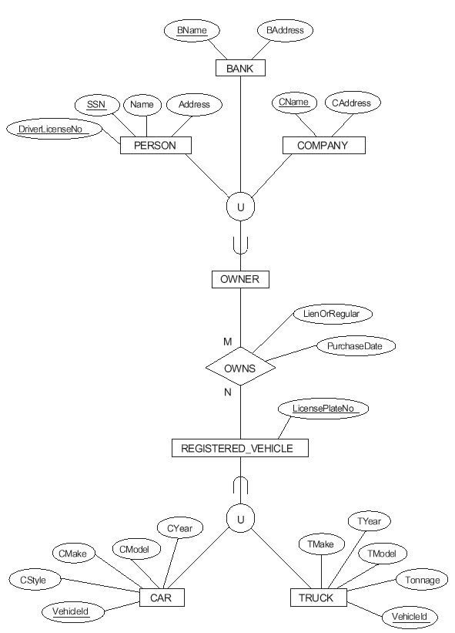
Illustration of how to represent the UNION of two or more entity types/classes using the category notation. Two categories are shown: OWNER and REGISTERED_VEHICLE.

Slide 25
Aggregation
Aggregation refers to the process by which entities are combined to form a single meaningful entity.
The specific entities are combined because they do not make sense on their own.
To establish a single entity, aggregation creates a relationship that combines these entities.
Aggregation is a process that represent a relationship between a whole object and its component parts.
It abstracts a relationship between objects and viewing the relationship as an object.
It is a process when two entity is treated as a single entity.

Slide 26
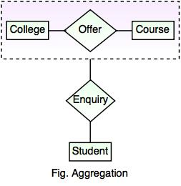
In the example, the relation between College and Course is acting as an Entity in Relation with Student.

Slide 27
Mapping specialization/generalization to relational tables
Specialization/generalization relationship can be mapped to relational tables in three methods.
To demonstrate the methods, we will take the student, postgraduate and undergraduate relationship.
A student in the university has a registration number and a name.
Only postgraduate students have supervisors. Undergraduates accumulates points through their coursework.

Slide 28
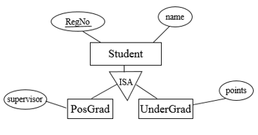
Method 1
All the entities in the relationship are mapped to individual tables.
Student (Regno, name)
PosGrad (Regno, supervisor)
UnderGrad (Regno, points)
Method 2
Only subclasses are mapped to tables. The attributes in the superclass are duplicated in all subclasses.
PosGrad (Regno, name, supervisor)
UnderGrad (Regno, name, points)
Method 3
Only the superclass is mapped to a table. The attributes in the subclasses are taken to the superclass.
Student (Regno, name, supervisor, points)

Slide 29
Features of EER Model
EER creates a design more accurate to database schemas.
It reflects the data properties and constraints more precisely.
It includes all modeling concepts of the ER model.
Diagrammatic technique helps for displaying the EER schema.
It includes the concept of specialization and generalization.
It is used to represent a collection of objects that is union of objects of different of different entity types.

Slide 30
Theory Digital Assignment 1 and 2
Although you always wanted to be an artist, you ended up being an expert on databases. Your old love is still there, however, so you set up a database company, Art Base that builds a product for art galleries. The core of this product is a database with a schema that captures all the information that galleries need to maintain. Galleries keep information about artists, their names (which are unique), birthplaces, age, and style of art. For each piece of artwork, the artist, the year it was made, its unique title, its type of art (e.g., painting, lithograph, sculpture, photograph), and its price must be stored. Pieces of artwork are also classified into groups of various kinds, for example, portraits, still lifes, works by Picasso, or works of the 19th century; a given piece may belong to more than one group. Each group is identified by a name (like those just given) that describes the group. Finally, galleries keep information about customers. For each customer, galleries keep that person’s unique name, address, total amount of dollars spent in the gallery (very important!), and the artists and groups of art that the customer tends to like.
Draw the ER diagram for the database and apply Extended ER digarams features whenever possible
Convert the Drawn ER diagram into Relational Schema

